Slide 1


SAP UI5 & FIORI with OData TRAINING
Anubhav Oberoy & Shekhar Vedi
Day – 6

Slide 2

Agenda – Day 6
Control Hierarchy
Concept of Base Controller in UI5
Concept of binding in UI5
Expression Binding
Binding Modes
Aggregation Binding
Element Binding

Slide 3
Control Hierarchy
sap.ui.base.ManagedObject
Syntax to create object
var oName = new libraryName.ControlName({
prop: Val,…
});
Note:- Whenever we see a control, and if we are unable to find a property, association, event or function in that class, check its parent class.
sap.ui.core.Element
sap.ui.core.Control
sap.m.Button
sap.m.InputBase
sap.ui.view
sap.m.Table
sap.ui.layout.form
sap.m.Input
SimpleForm
sap.m.Column
Some of the Frequently used controls in SAP

Slide 4
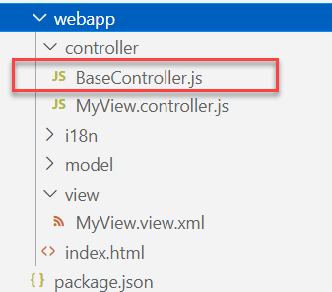
Concept of Base Controller in UI5
Base Controller:- A base controller is a controller with basic functionalities from which the other controllers in your SAPUI5 application inherit.
The base controller holds basic functionalities that are used across multiple controllers.
The base controller itself is just another JavaScript file and it does not have the .controller prefix. Just BaseController.js and not BaseController.controller.js.
The base controller goes in the controller folder in your SAPUI5 application folder structure:
sap/ui/core/mvc/Controller
x
BaseController
Template
x
Controller 1
x
Controller 2
x
Controller 3
x
Controller 4
View 1
View 2
View 3
View 4

Slide 5

Exercise
In this exercise we will create a new BaseController.
Along with that we will see how to load data to a model from a file.
Exercise code/resources: -
MyView.view.xml
MyView.controller.js
BaseController.js
mydata.json
mydata2.json
mydata.xml
model.js

Slide 6

Concept of Binding in SAP UI5
Data binding is the process that establishes a connection between the application UI and business logic.
It is a bridge between a binding target and a binding source.
Sap ui5 provides three binding options
Property Binding
Expression Binding
Aggregation Binding
Element Binding
Property Binding:- When we bind property of a UI control, to the address of the model, this is called property binding. E.g., value property of Input control was connected to /emp/empId
Ex:-
In XML view:- <Text text=“{/emp/empId}” ></Text>
In controller: - this.getView().byId(“controlId”).bindProperty(“text”, ‘/emp/empId’);

Slide 7
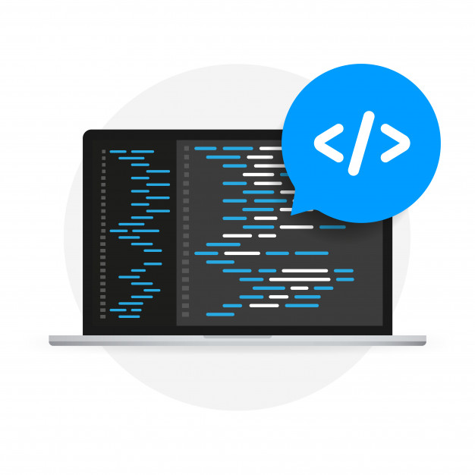
Expression Binding
Expression binding : - When we bind an Expression ({= condition ? true : false}) with the property of a control rather binding value to a property, this is called expression binding.
If we need some calculation on model data or some sort of comparison, then expression binding is useful.
Syntax:
numberState = “{= ${path} > value ? ‘conditionForTrue’ : ‘ConditionForFalse’ }”
Use Case of Expression Binding
My Manager want to add a button and when we click on that button, all the fields should gray out.
If The Employee Name is Anubhav, Gray out Salary field.
Condition – if employee name = Anubhav
Outcome – make field gray out
Target – Salary field

Slide 8

Exercise
In this exercise we will see the example of both property binding and expression binding.
In this file we also see that how to get data form the file in the model.
Exercise code:-
MyXML.controller.js
MyXML.view.xml
index.html

Slide 9
Binding Modes
There are basically three modes of binding data in SAPUI5.
One-way binding – Here, the data is transported in one direction only, i.e., from the model, through the binding instance to the consumer (usually the property of a control), but never in the other direction. Any change done on the model data from the front end is not affected to the model. All the data changes are reflected only on the controls.
Two-way binding – Here all input changes done from front end controls are reflected on the model and the backend database. SAPUI5 automatically handles the transport of data both from the model to the controls and back from the controls to the model.
One-time binding – Here all data will be bound from model to view just once. After that, the connection is no more set.
Data
Data
Model
View
Model
View
Data
One-way binding
Two-way binding
Date
Date
Date
Model
View
Model
View
One-Time binding

Slide 10
Aggregation Binding
When we bind the aggregation of a control with the entityset of data model, it is called aggregation Binding.
The parent control (e.g. Table) is bound to the EntitySet path which is called absolute path and the child of the parent Control (e.g. Columns) are connected to the child properties of the EntitySet is called relative path.
In aggregation binding, based on your model data, as many child controls will be created automatically.
Every Event of UI5 will trigger the eventHandler and we will get the Event Object as part of the event Handler. Depending on the event, the event handler object will have different parameters.
Use Case of Aggregation Binding
If we want to show a list or some data in tabular format, we need to bind a group of data. In such a case we will use aggregation binding.
Absolute path
{
“empTab”: [
{
“empId”: 50,
“empName”: “Jay”,
“salary”: 9500
}
]
}
Table = {/empTab}
Emp Id | Emp Name | Salary
{empId} | {empName} | {salary}
Relative Paths

Slide 11

Exercise
In this exercise we will create a table and load the data of some employees in it.
We will see how to use different controls in a table to represent data.
Exercise code/resource:-
MyView.view.xml
MyView.controller.js
mydata.json

Slide 12

End of Day 6

Slide 13

Questions

Slide 14

Anubhav Oberoy

Slide 15


We’re committed to empower you to be
Most Desirable Resource
through powerful training solutions.
We build the workforce of the future.
250+
Corporate Clients
30,000+
Learners Trained
25000+
Learners Placed
FREE WEBINARS
Sign up for free webinars with industry experts every fortnight!
Enroll Now!
Contact us today!
https://anubhavtrainings.com/

Slide 16




More from AnubhavTrainings.com

Slide 17
Title
Content

